Slide 1
BeamBench
-
Understanding LoS requirement
Team Avatar
Maximilian Arnold

Slide 2
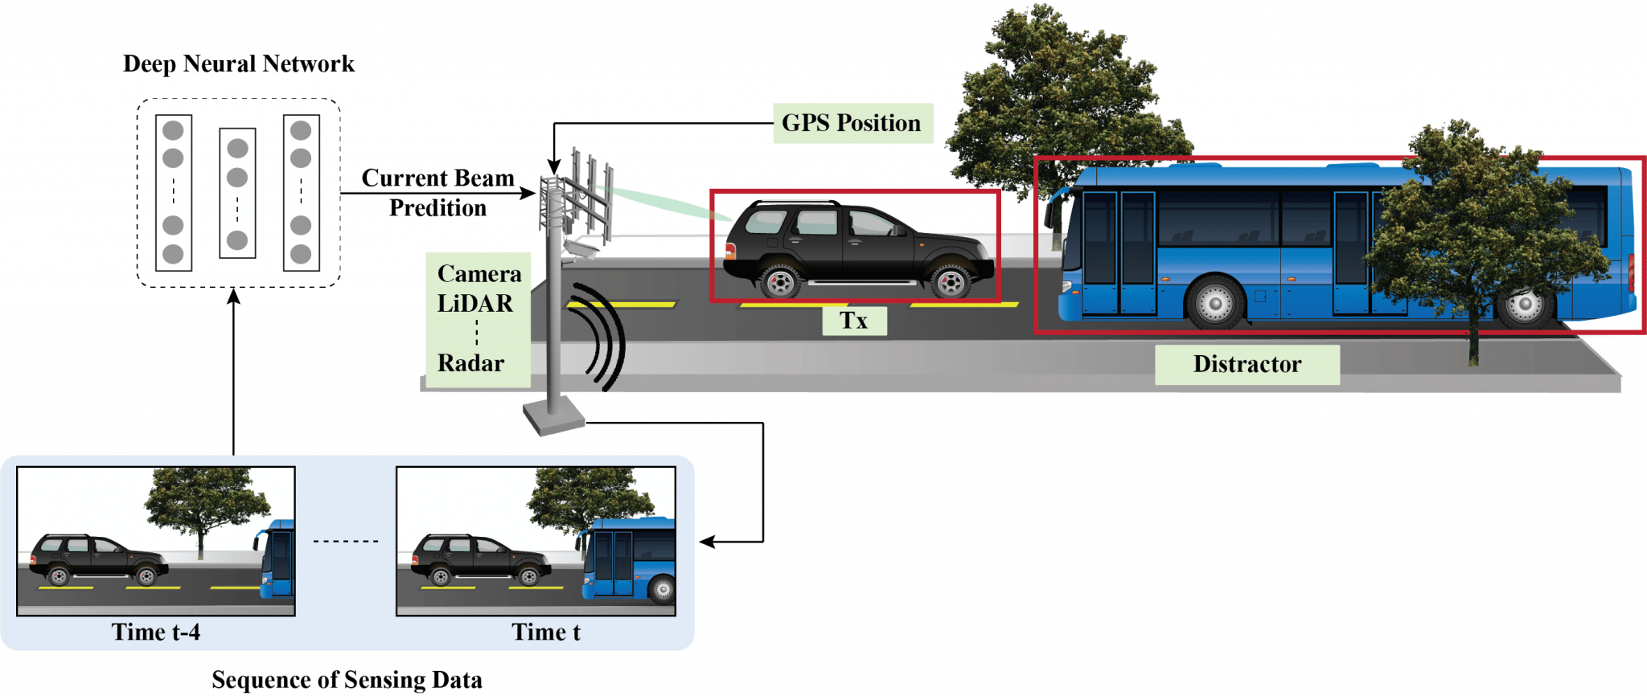
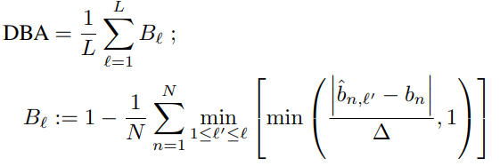
Beam prediction task – Overall structure (1/2)
Find target in Sensor (e.g. Camera)
Detect best path towards target (electromagnetic)
Use highest power from codebook in this direction
Beamprediction in general [1]
Multi-stage detection problem
In mmWave (>6GHz carrier frequency) beams are highly directive → Is the task to find the target only?
[1] https://deepsense6g.net/multi-modal-beam-prediction-challenge/

Slide 3
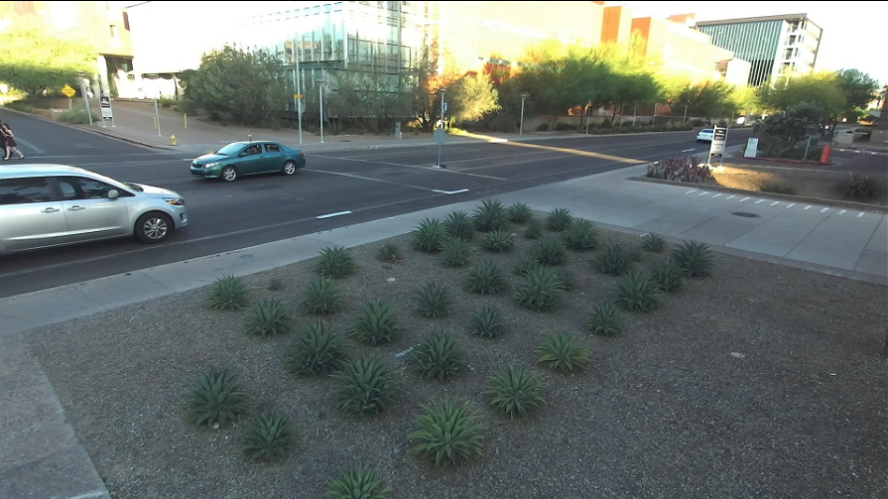
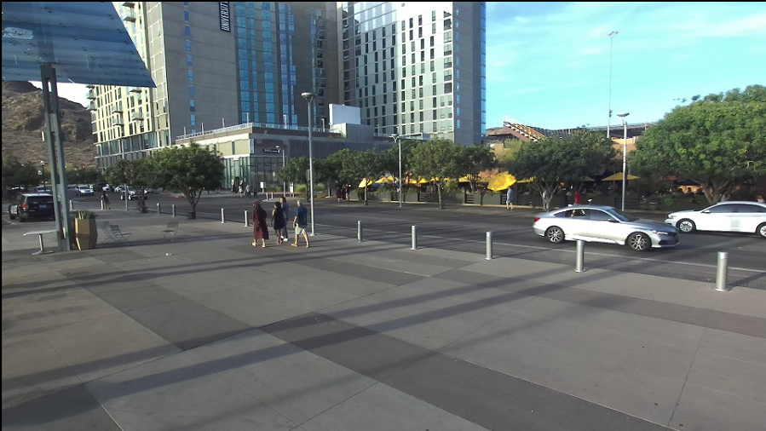
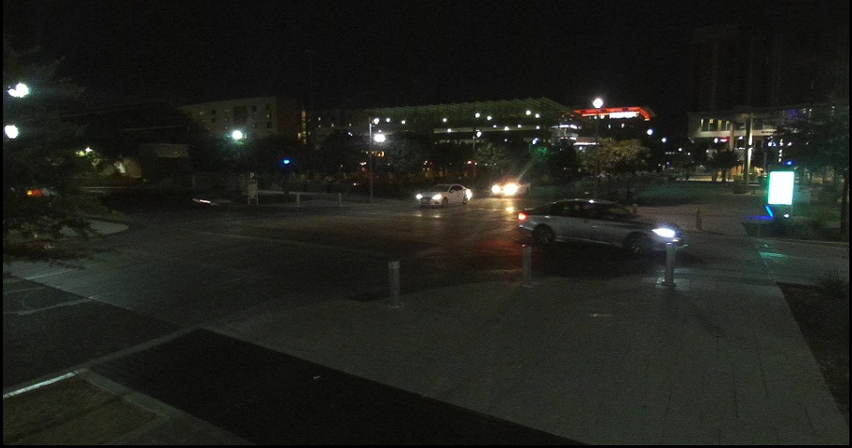
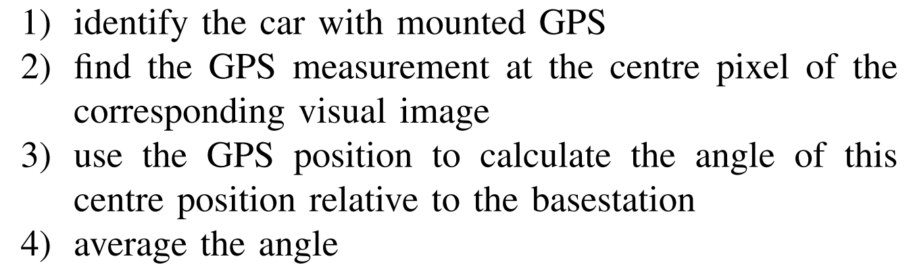
Beam prediction task – Translation between scenery (2/2)
Real challenge is generalization:
Cars look different (as a target)
Settings (Field of View) angle and rotation is completely different among scenarios (distribution shifts)
→ Calibration of data is a reasonable first step:

Slide 4
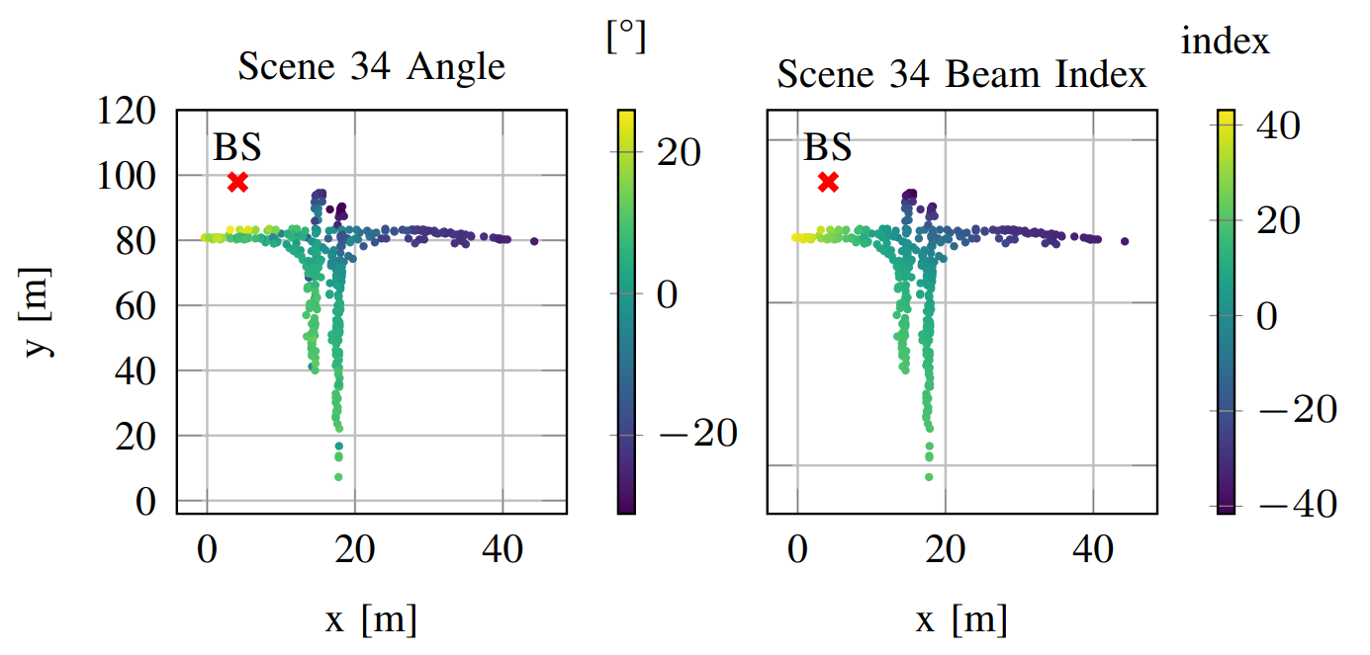
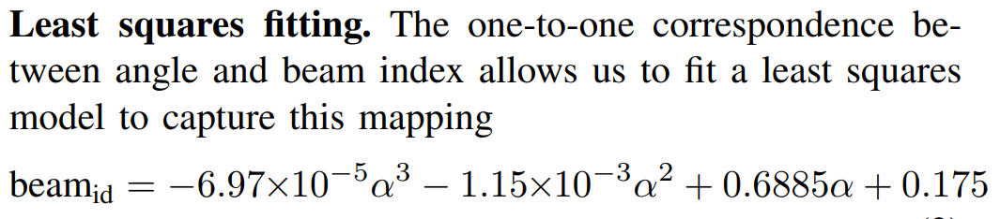
Connection Line-of-Sight (LoS) Speed, Beam Index
The baseline
We only have an outdated GPS angle (~200ms) but in LoS cases the Beam Index matches quite well. → Least squares fitting
Additional gains are scenario depending making generalization very hard

Slide 5
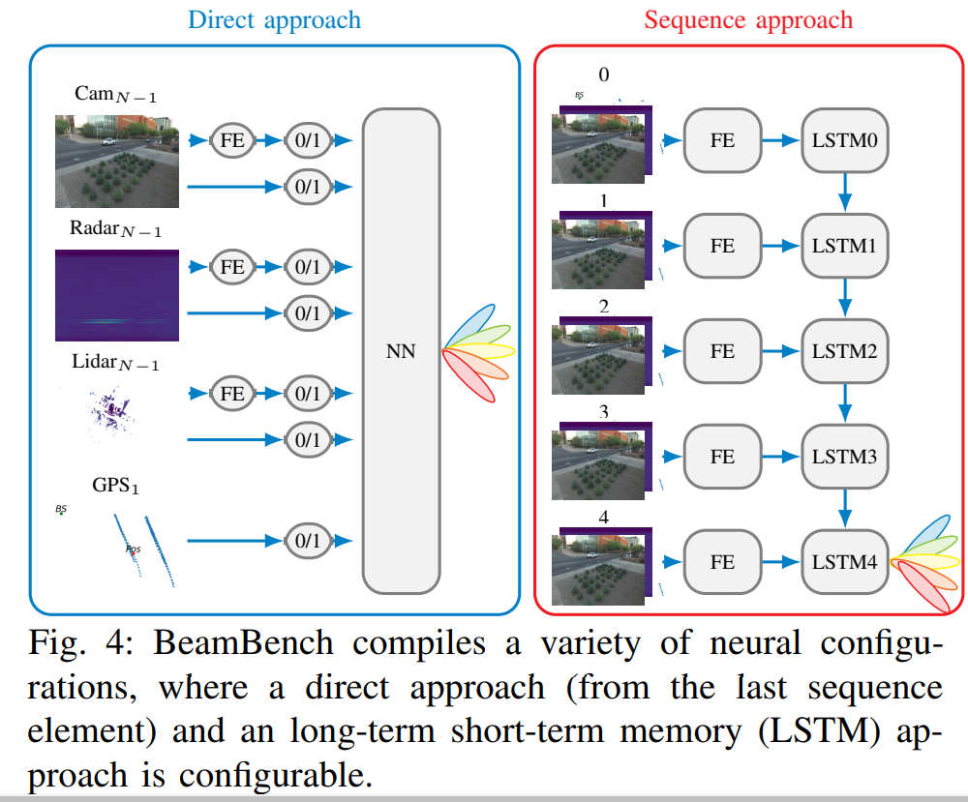
BeamBench – Universal prediction tool

Slide 6
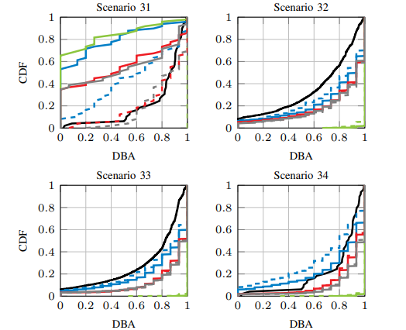
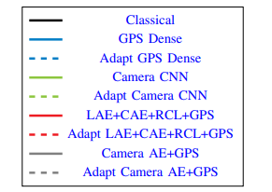
Overall pretraining and adaptation
No real generalization but the tendency towards it

Slide 7
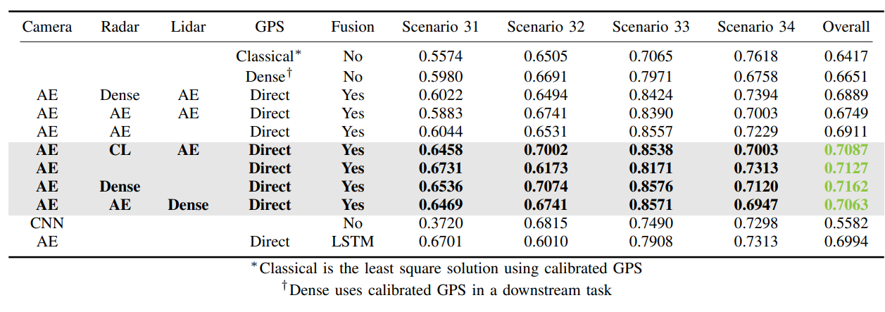
Overall results
GPS as a regularizer and additional Sensor information is quite powerful

Slide 8
Questions?

